Slide 1
Sales’Up Quick Filters for Creatio

Slide 2
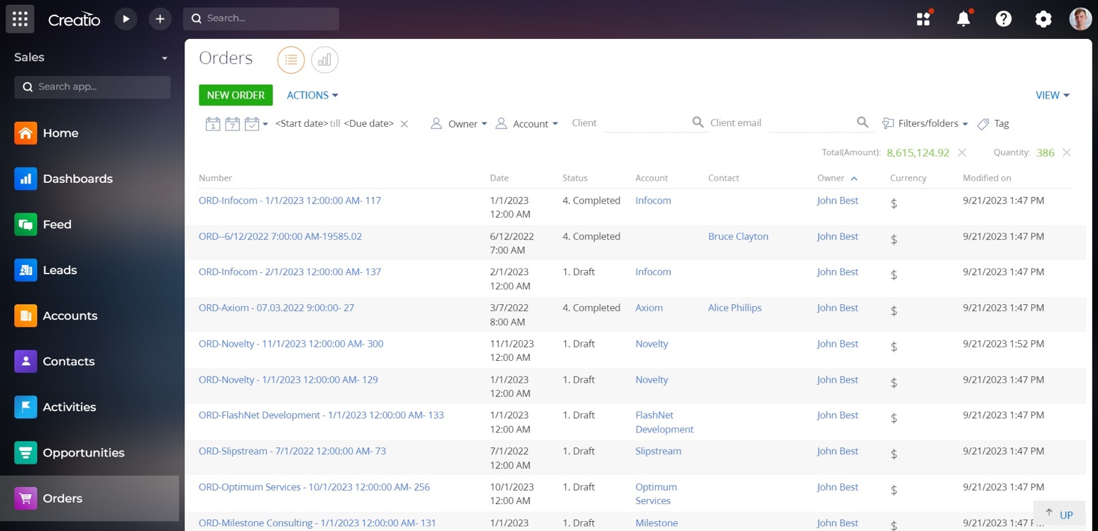
SalesUp Quick filters for Creatio allows to set up quick filters in system sections and details dynamically without involving developers. The app conveniently enables you to add or change customized quick filters in any system registry. With this app, you can also configure a hierarchical catalog with section data. Configuration is performed in a separate convenient setup wizard.

Slide 3
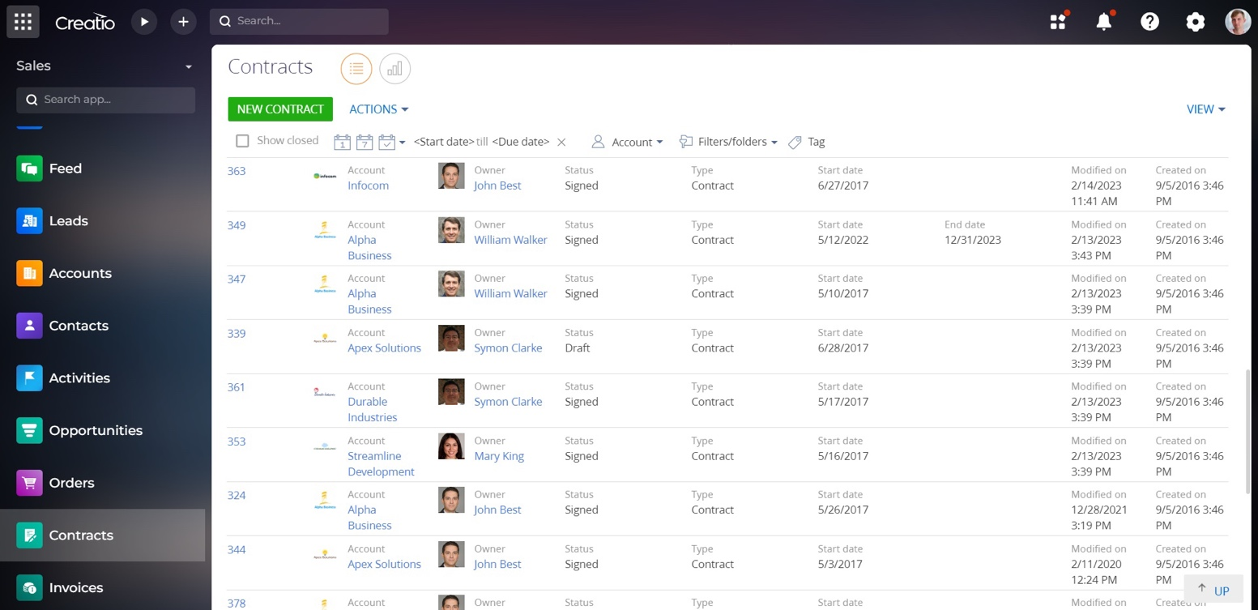
Use cases:
Filtering by date of sections record;
Filtering by assignee;
Displaying or not displaying the archive records;
Displaying or not displaying records by statuses;
Section records organization as a catalog.

Slide 4
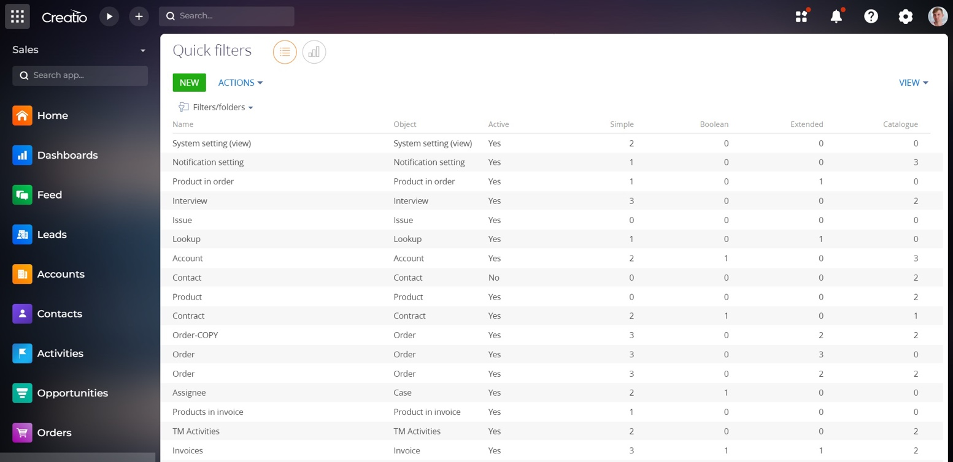
Key features:
Adding an unlimited number of filter settings;
Setting up quick filters in sections and details;
Filtering by object columns of the section or details;
Adding arbitrary advanced filters;
Setting up filtering templates;
Displaying data as a tree view.

Slide 5
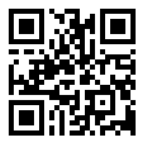
THANK YOU!
CONTACT US:
salesup-it.com
care@salesup-it.com

